Slide 1


HUMAN ACTIVITY RECOGNITION
Manidhar Kodurupaka Balmukund Mishra(Mentor)
K.Natesh Reddy Shambhavi Mishra(Mentor)
Akash Wadhw M
Konduru Chandra Harshitha

Slide 2
Introduction
The drones are deployed, and the activity of humans are recognized for seeking-help and the live GPS location of the person is sent to the database and the rescue team can save them.
This project could be helpful during the natural disasters/calamities for searching and rescuing people.
Natural disasters like Floods, Earthquakes etc.

Slide 3
Dataset Used
The dataset is created by capturing video feed of scenario consisting of humans and multiple other objects, using Drone.
UCF-101 Dataset is been used
Kinetics 700 Dataset &
Drone collected Dataset(Help , Non-Help)

Slide 4
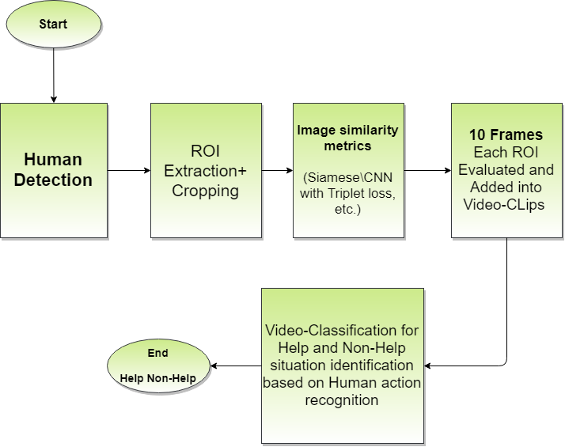
Methodology / Model Used
Fig. 1. Complete Architecture of Search and Rescue based on Background
Invariant Generalization of Deep learning models

Slide 5
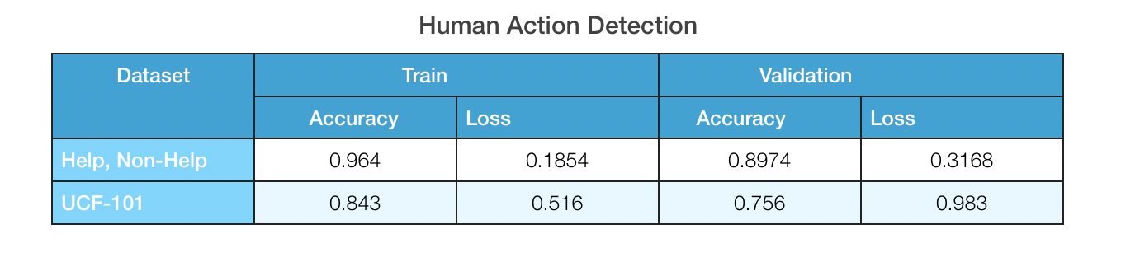
Table Results
Table 1: Accuracy Table

Slide 6
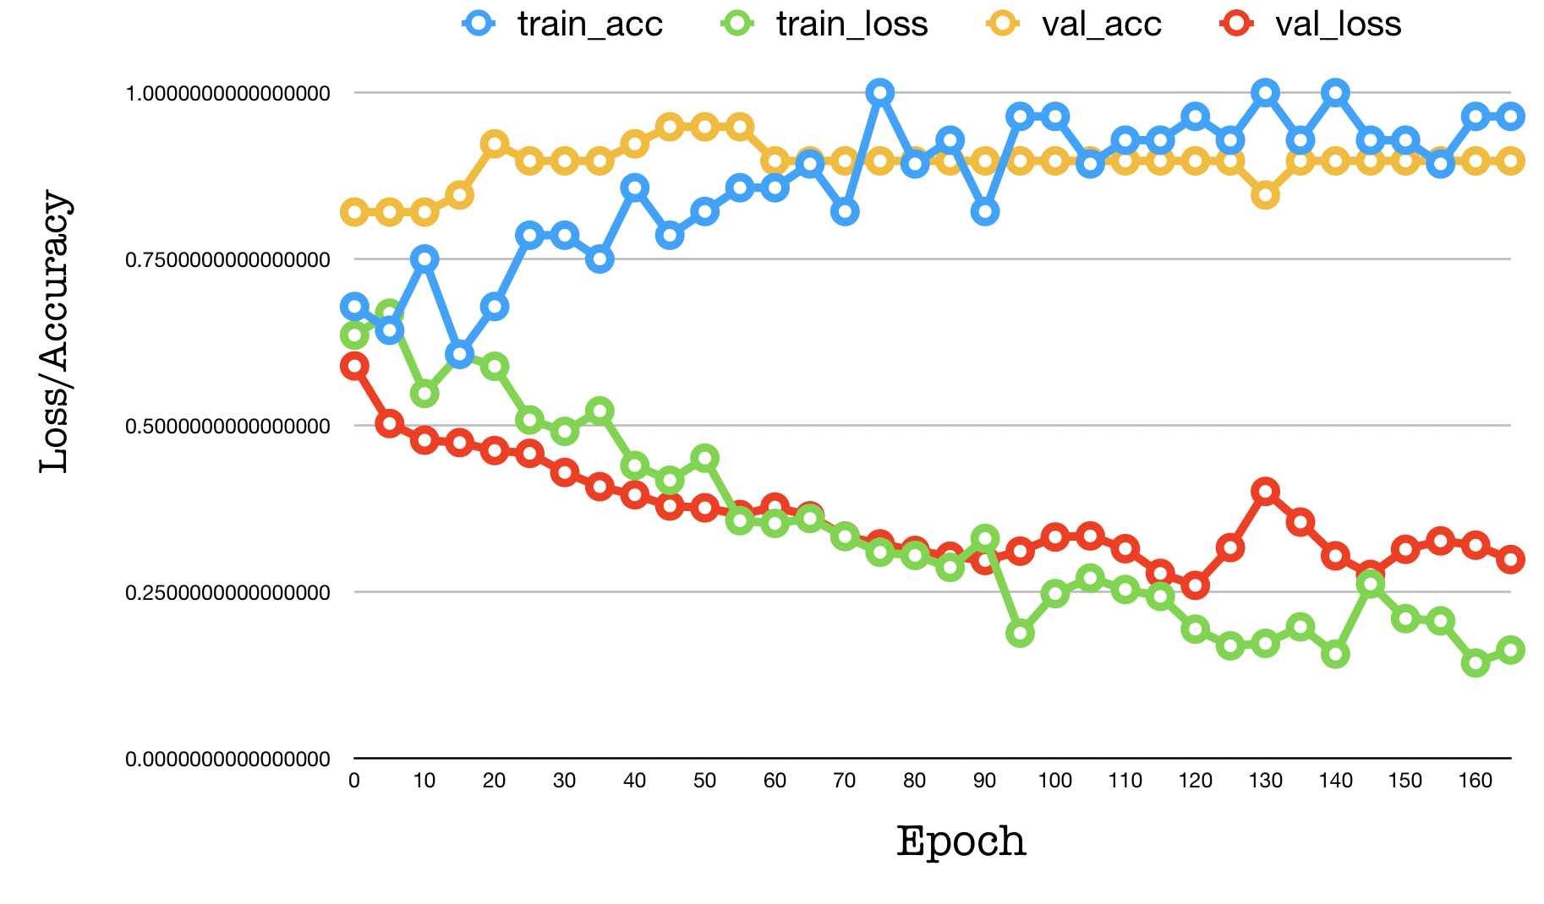
Results Achieved
Fig 2: On Help and Non-Help Video Dataset

Slide 7
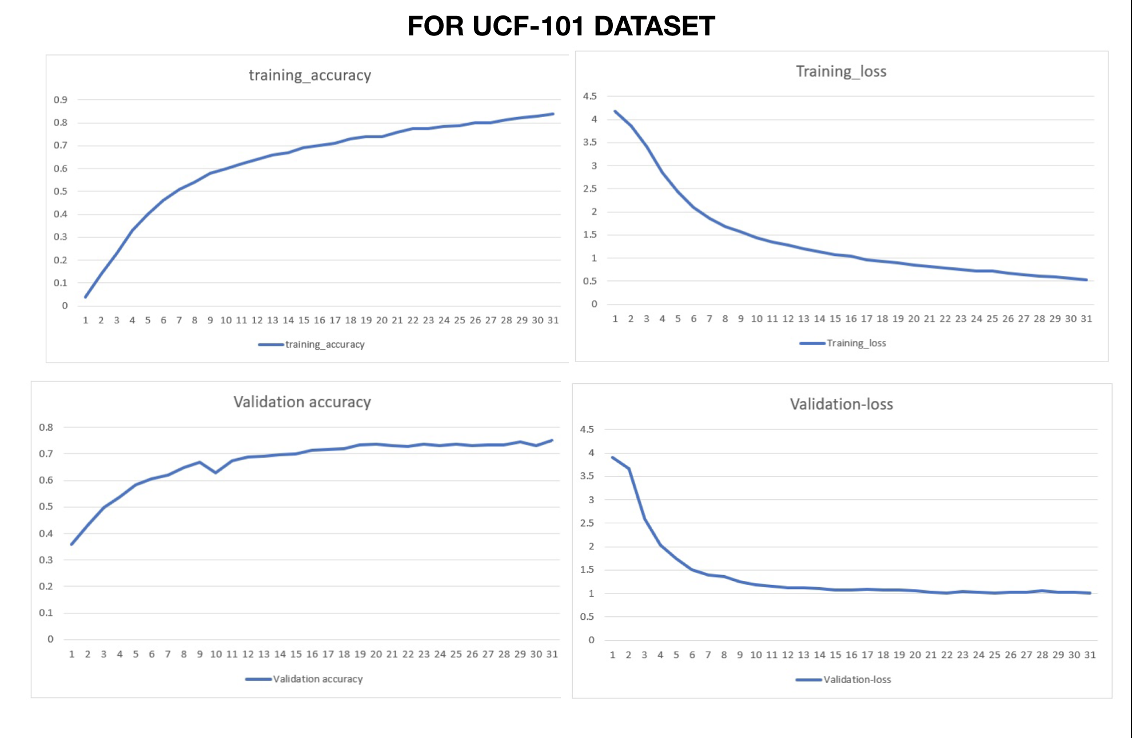
Results Achieved
Fig 3: On UCF-101 Video Dataset

Slide 8
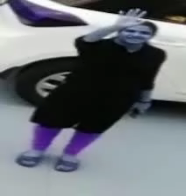

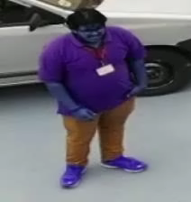
INPUT VIDEOS
HELP
HELP
NON-HELP

Slide 9
Conclusion
With the model and architecture we have designed, the project works fine with the dataset we have created using drones.
This can be further taken into real-time deployment of this model as the accuracy and prediction was satisfied and could be useful during the disasters.
The CNN-RNN algorithm provides us with an accuracy of 96.4% on the video dataset for Help , Non-Help.

Slide 10
References
Some references used for this project are:
Rémy, Guillaume, et al. "SAR. Drones: drones for advanced search and rescue missions." Journées Nationales des Communications dans les Transports 1 (2013): 1-3.
Naqvi, Syed Ahsan Raza, et al. "Drone-aided communication as a key enabler for 5G and resilient public safety networks." IEEE Communications Magazine 56.1 (2018): 36-42. P. Kopyt et al., “Electric properties of graphene-based conductive layers from DC up to terahertz range,” IEEE THz Sci. Technol., to be published. DOI: 10.1109/TTHZ.2016.2544142.

Slide 11
Thank You

